Slide 1
MIS 3301 Intro. to Business Programming Logic
Files and Exceptions
Part 1 – Working with CSV Files
Mrs. Nancy G. Sánchez

Slide 2
Outline
Intro to Files
File types & File access
CSV Files
Opening & Closing Files
Processing CSV Files:
Reading
Searching for a record
Writing
Updating
Deleting

Slide 3
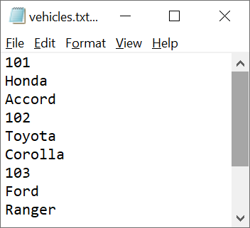
Textbook Approach
NOTE: We will not be using the file processing approach in our textbook as it generates a TXT file and writes one field per line.
Instead we will be working with CSV Files.
Thus, in Ch 6, only read the following pages:
Intro: 287-292
Exception Handling 324-227
TXT File

Slide 4
Intro to Files

Slide 5
Intro to Files
Types of Files
Text file - contains data that has been encoded as text
TXT, CSV, etc.
Binary file - contains data that has not been converted to text
File Access
Sequential access - file read sequentially from beginning to end, can’t skip ahead
Direct access - can jump directly to any piece of data in the file

Slide 6
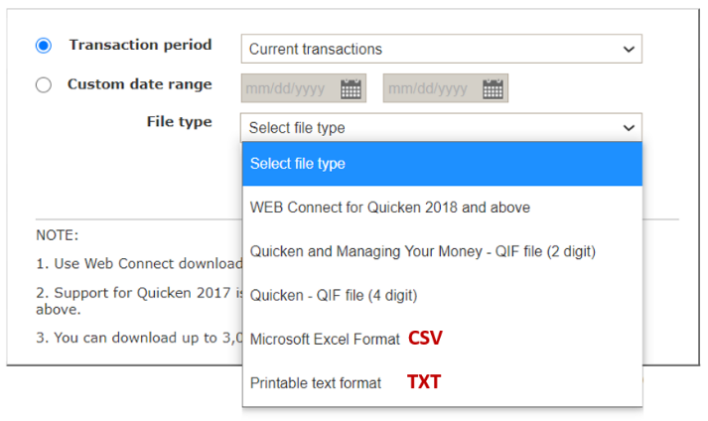
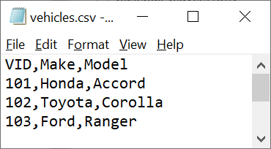
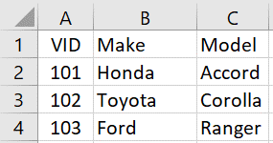
CSV Files
Comma Separated Values
Delimiter: ','
Benefits:
It is a popular file type; sometimes used to import/export data to/from other applications.
CSV files can be opened in Excel and presents our data in a more readable format
Bank Transactions Download
CSV File

Slide 7
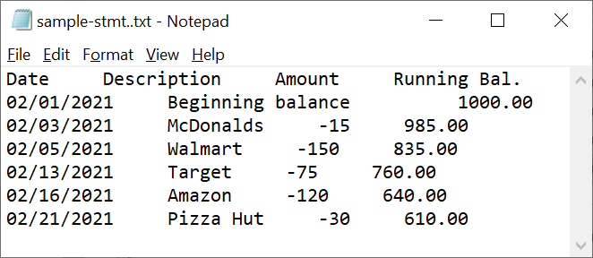
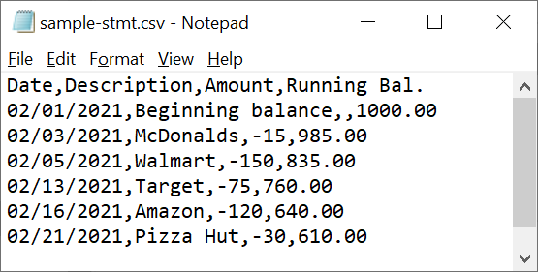
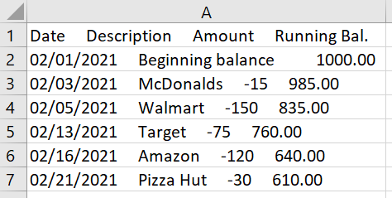
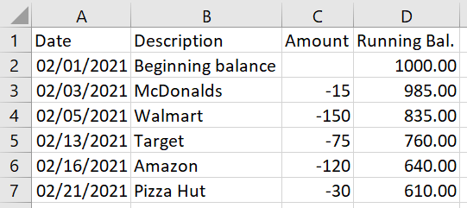
TXT Files vs CSV Files
TXT - no delimiter
CSV – comma delimiter
Notepad
Notepad
Excel
Excel

Slide 8
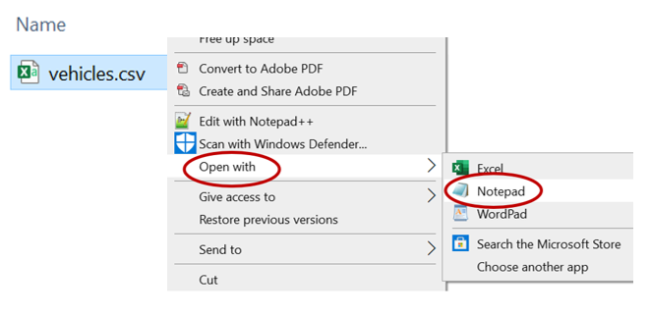
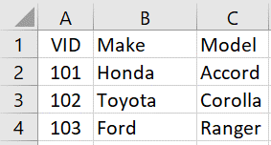
Opening a CSV File in Excel & Notepad
In Excel
In Notepad

Slide 9
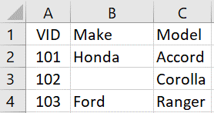
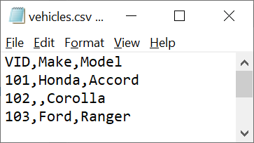
CSV Files with missing data
Some files may have empty values
Excel
Notepad
Missing values
If you need to write an empty cell, you will write: ''

Slide 10
Opening & Closing Files

Slide 11
Opening & Closing Files
def main():
#open the file
infile = open('vehicles.csv', 'r')
#additional code for processing
#close file
infile.close()
main()
open('vehicles.csv', 'r')
vehicles.csv
instantiates
r
open function
infile
file object
provides a way for a program to communicate with a file
close method
open('vehicles.csv', 'w')
vehicles.csv
instantiates
File Mode options:
‘r’ - opens a file for reading; error if the file does not exist – FileNotFoundError.
‘w’ - opens a file for writing; creates the file if it does not exist.
‘a’ - opens a file for appending; creates the file if it does not exist.
w
outfile
file object

Slide 12
Opening & Closing Files – an alternate approach
open('vehicles.csv', 'r')
Optional
Using the with statement
vehicles.csv
instantiates
def main():
#open the file
with open('vehicles.csv', 'r') as infile:
#additional code for processing
main()
r
infile
file object
Place all File processing code
in the with block
provides a way for a program to communicate with a file
Do not close
Can also write 2 open() functions
with open('vehicles.csv', 'r') as infile, \
open('vehicles.csv', 'w', newline='') as outfile:
Benefit:
Python automatically closes the file when you leave the nested block, regardless of how you exited (i.e. fell to the bottom, called a break, etc.

Slide 13
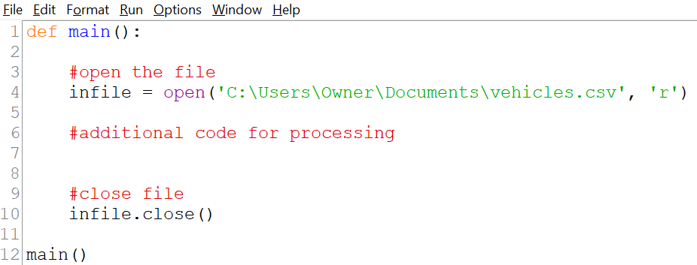
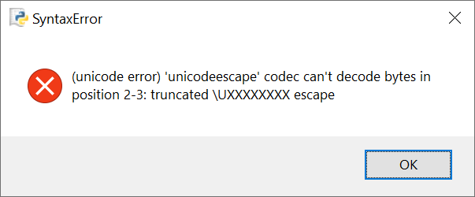
File Path
When including a path with a file name, use a raw string → r
Defining the string as a raw string causes the backslashes in the string to be interpreted as actual backslashes and not escape characters
def main():
#open the file
infile = open(r'C:\Users\Owner\Documents\vehicles.csv', 'r’)
#additional code for processing
#close file
infile.close()
main()
Complaining about the \U

Slide 14
Processing CSV Files
Reading
Searching
Writing
Updating
Deleting

Slide 15
FILE Functions & Methods
There are several built-in file functions & method that we will be using:
Standard Library
Built-in
functions
methods
Method
A special type of function that belongs to an object
Methods must be prefaced with an object name.
open()
next()
close()
Preface with
a file object
csv module
functions
methods
reader()
writer()
writerow()
writerows()
import csv
Preface with
a writer object

Slide 16
CSV File - READING Records
Programming Logic to
start READING
open('vehicles.csv', 'r')
csv.reader(infile)
CSVFILE = 'vehicles.csv'
vehicles.csv
instantiates
instantiates
r
infile = open(CSVFILE, 'r')
infile
file object
reader
reader object
(an iterable)
reader = csv.reader(infile)
provides a way for a program to communicate with a file
Will return each row of data as a list of strings
for row in reader:
….
….

Slide 17
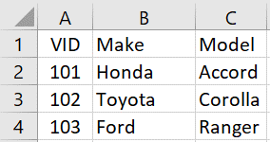
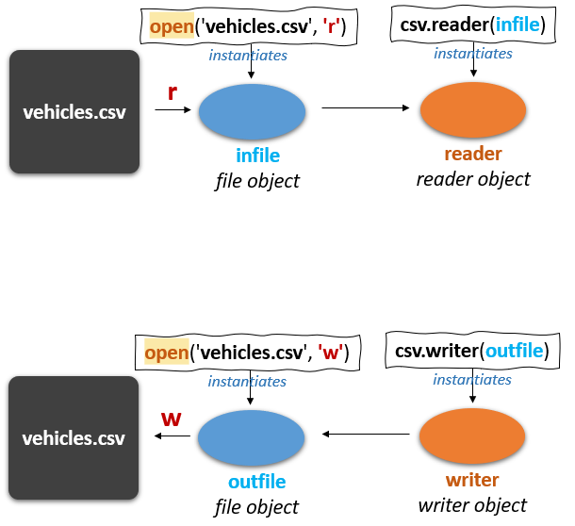
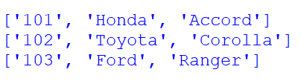
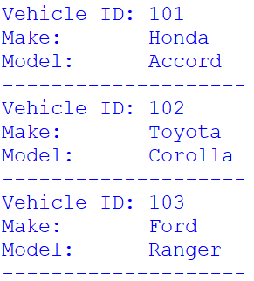
CSV File - READING Records
#Import
import csv
#Global constants
CSVFILE = 'vehicles.csv'
def main():
#Open file for READING
infile = open(CSVFILE, 'r')
#Create reader object
reader = csv.reader(infile)
#Skip field names row
next(reader)
#Display all records
for row in reader:
print('Vehicle ID:', vid)
print('Make: ', make)
print('Model: ', model)
print('-'*20)
#Close the file
infile.close()
main()
row[0]
row[1]
row[2]
row
row
next()
Returns the current row
& moves the iterator
to the next row
row
#Extract values from the row
vid = row[0]
make = row[1]
model = row[2]
TIP: To pause after reading records:
input('\nPress enter to continue...\n')
Add this code at top of loop

Slide 18
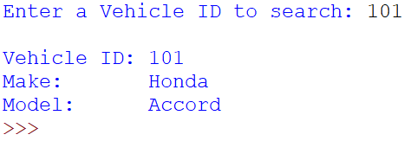
CSV File - SEARCHING Records
#Import
import csv
#Global constants
CSVFILE = 'vehicles.csv'
def main():
found = False
#Open file for READING
infile = open(CSVFILE, 'r')
#Create reader object
reader = csv.reader(infile)
#Skip field names row
next(reader)
#Prompt user for search value
search_id = input('Enter a Vehicle ID to search: ')
print()
#Search & display record
for row in reader:
if vid == search_id:
found = True
print('Vehicle ID:', vid)
print('Make: ', make)
print('Model: ', model)
break
#Display status
if not found:
print('Vehicle ID not found')
#Close the file
infile.close()
main()
#Extract values from the row
vid = row[0]
make = row[1]
model = row[2]
Add this code at top of loop
On a READ, break as soon as it is found

Slide 19
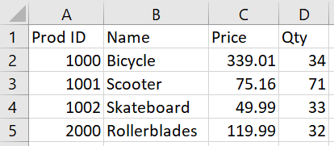
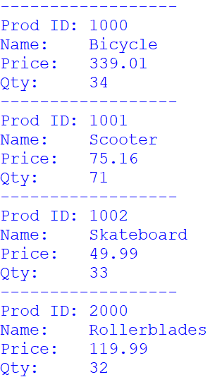
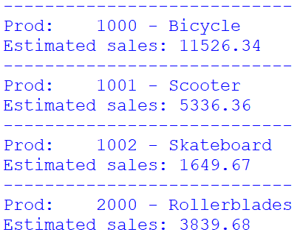
Exercise 1 – READING Records
Copy the code below and save it as Ch6-Ex01-Read-CSV.py
Download the file products.csv & products-BKUP.csv from Canvas
In class - write the code to read the products.csv dile & display the data formatted as Version 1
At Home - write the code to display the data formatted as Version 2
#Ch6-Ex01-Read-CSV.py
#Import
#Global constants
def main():
#Open file
#Create reader object
#Skip field names row
#Loop to display records
#Close file
main()
Version 1
Version 2

Slide 20
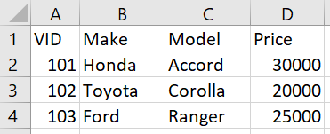
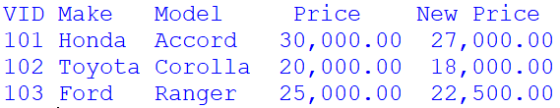
BEWARE when calculating
vehicles2.csv - has an extra column
#Import
import csv
#Global constants
CSVFILE = 'vehicles2.csv'
def main():
#Open file for READING
infile = open(CSVFILE, 'r')
#Create reader object
reader = csv.reader(infile)
#Display field names row
fields = next(reader)
print(fields[0], fields[1], fields[2], fields[3])
#Display all records
for row in reader:
#Extract values from the row
vid = row[0]
make = row[1]
model = row[2]
price = float(row[3])
#Perform calc
new_price = price * .90
#Display data
print(vid, make, model, price, new_price)
#Close the file
infile.close()
main()
next()
Returns the current row
& moves the iterator
to the next row
Convert
Numbers!
(except codes like VID)
Code does not include this formatting
print(format(fields[0],'3'), format(fields[1],'6'), format(fields[2],'7'), format(fields[3],'^10'), format('New Price','^10') )
print(format(vid,'3'), format(make,'6'), format(model,'7'), format(price,'10,.2f'), format(new_price,'10,.2f'))

Slide 21
Writing a CSV File
Programming Logic to
start WRITING
open('vehicles.csv', 'w')
csv.writer(outfile)
CSVFILE = 'vehicles.csv'
vehicles.csv
instantiates
instantiates
w
outfile = open(CSVFILE, 'w', newline='')
outfile
file object
writer
writer object
writer = csv.writer(outfile, delimiter = ',')
writer.writerow(fieldnames)
while cont != 'n':
….
writer.writerow(new_row)

Slide 22
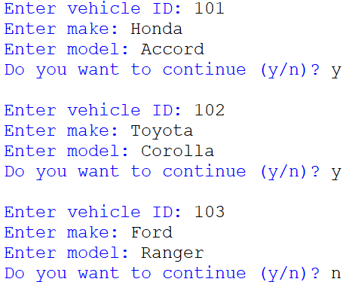
CSV File - WRITING Records
Add this or it will add a blank line between each record
#Import
import csv
#Global constants
CSVFILE = 'vehicles.csv'
def main():
#Open file for WRITING
outfile = open(CSVFILE, 'w', newline='')
#Create writer object
writer = csv.writer(outfile, delimiter = ',')
#Write field names
fieldnames = ['VID' , 'Make', 'Model']
writer.writerow(fieldnames)
#Write data record
cont = 'y'
while cont != 'n':
vid = input('\nEnter vehicle ID: ')
make = input('Enter make: ')
model = input('Enter model: ')
new_row = [vid, make, model]
writer.writerow(new_row)
cont = input('Do you want to continue (y/n)? ')
#Close the file
outfile.close()
main()
Use ‘a’ to append!
Comma is the default
writerow() only allows 1 argument; thus use a list
Must be a list!
If the file is open,
you cannot write to it.
PermissionError: [Errno 13]
Permission denied: 'vehicles.csv'

Slide 23
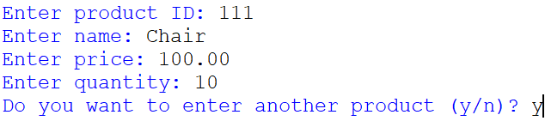
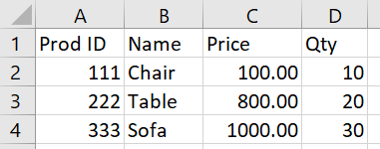
Exercise 2 – WRITING Records
Copy the code below and save it as Ch6-Ex02-Write-CSV.py
Write the code to allow a user to enter the data to produce this file: products-new.csv
#Ch6-Ex02-Write-CSV.py
#Import
import csv
#Global constants
??? = 'products-new.csv'
def main():
#Open file for WRITING
???? = open(???)
#Create writer object
???? = ???.writer(???)
#Write field names
????? = 'Prod ID', 'name', 'Price', 'Qty'
#Loop to write each user-inputted record
cont = 'Y'
while cont.lower() == 'Y':
prod_id = input('Enter product ID: ')
name = input('Enter name: ')
price = float(input('Enter price: '))
qty = int(input('Enter quantity: '))
#write out row of data
??
cont = input('Do you want to enter another product (y/n)? ')
#Close the file
???.close()
main()
products-new.csv

Slide 24
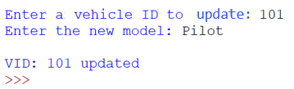
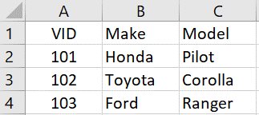
CSV File - UPDATING Records
#Import
import csv
import os
#Global constants
DELIM = ','
CSVFILE = 'vehicles.csv'
TEMPFILE = 'vehicles-temp.csv'
def main():
found = False
#Open files
infile = open(CSVFILE, 'r')
outfile = open(TEMPFILE, 'w', newline='')
#Create reader & writer objects
reader = csv.reader(infile)
writer = csv.writer(outfile, delimiter = ',')
#Read & write field names
fieldnames = next(reader) #from infile
writer.writerow(fieldnames) #to outfile
#Prompt user for value
search_id = input('Enter a vehicle ID to update: ')
print()
#Update data record
for row in reader:
if vid == search_id:
found = True
new_model = input('Enter the new model: ')
new_row = [vid, make, new_model]
writer.writerow(new_row)
else:
writer.writerow(row)
#Display status message
if found:
print('Vehicle updated')
else:
print('Vehicle ID not found')
#close files
infile.close()
outfile.close()
#Replace original file w/the new file
os.remove(CSVFILE)
os.rename(TEMPFILE, CSVFILE)
main()
#Extract values from the row
vid = row[0]
make = row[1]
model = row[2]
These are strings;
Convert, if necessary
Add this code at top of loop
Open 2 files
Must be a list!
Write the
Original VID & make
Write the
new model
Updated record
TEMP is not a BKUP File!!
Updated from ‘Accord’

Slide 25

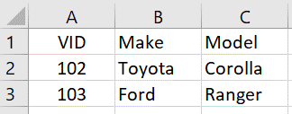
CSV File - DELETING Records
#Import
import csv
import os
#Global constants
DELIM = ','
CSVFILE = 'vehicles.csv'
TEMPFILE = 'vehicles-temp.csv'
def main():
found = False
#Open files
infile = open(CSVFILE, 'r')
outfile = open(TEMPFILE, 'w', newline='')
#Create reader & writer objects
reader = csv.reader(infile)
writer = csv.writer(outfile, delimiter = ',')
#Read & write field names
fieldnames = next(reader) #from infile
writer.writerow(fieldnames) #to outfile
#Prompt user for value
search_id = input('Enter a vehicle ID to delete: ')
print()
#Delete data record
for row in reader:
if vid == search_id:
found = True
else:
writer.writerow(row)
#Display status message
if found:
print('Vehicle deleted')
else:
print('Vehicle ID not found')
#Close files
infile.close()
outfile.close()
#Replace original file w/the new file
os.remove(CSVFILE)
os.rename(TEMPFILE, CSVFILE)
main()
#Extract values from the row
vid = row[0]
make = row[1]
model = row[2]
These are strings;
Convert, if necessary
To delete, simply do not write the record
Add this code at top of loop
Open 2 files
101 deleted
Deleted record
TEMP is not a BKUP File!!

